Slide 1
Neural Encoding and Decoding with Deep Learning
2017. 09. 08

Slide 2
Keyword
Neural Encoding/Decoding
or
Brain Encoding/Decoding

Slide 3
Central question
How the brain represents visual information?
Whether one may decode brain activity to reconstruct what a person is seeing

Slide 4
This topic is…
2011
2017
This topic
2017
1998
Deep learning

Slide 5
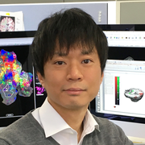
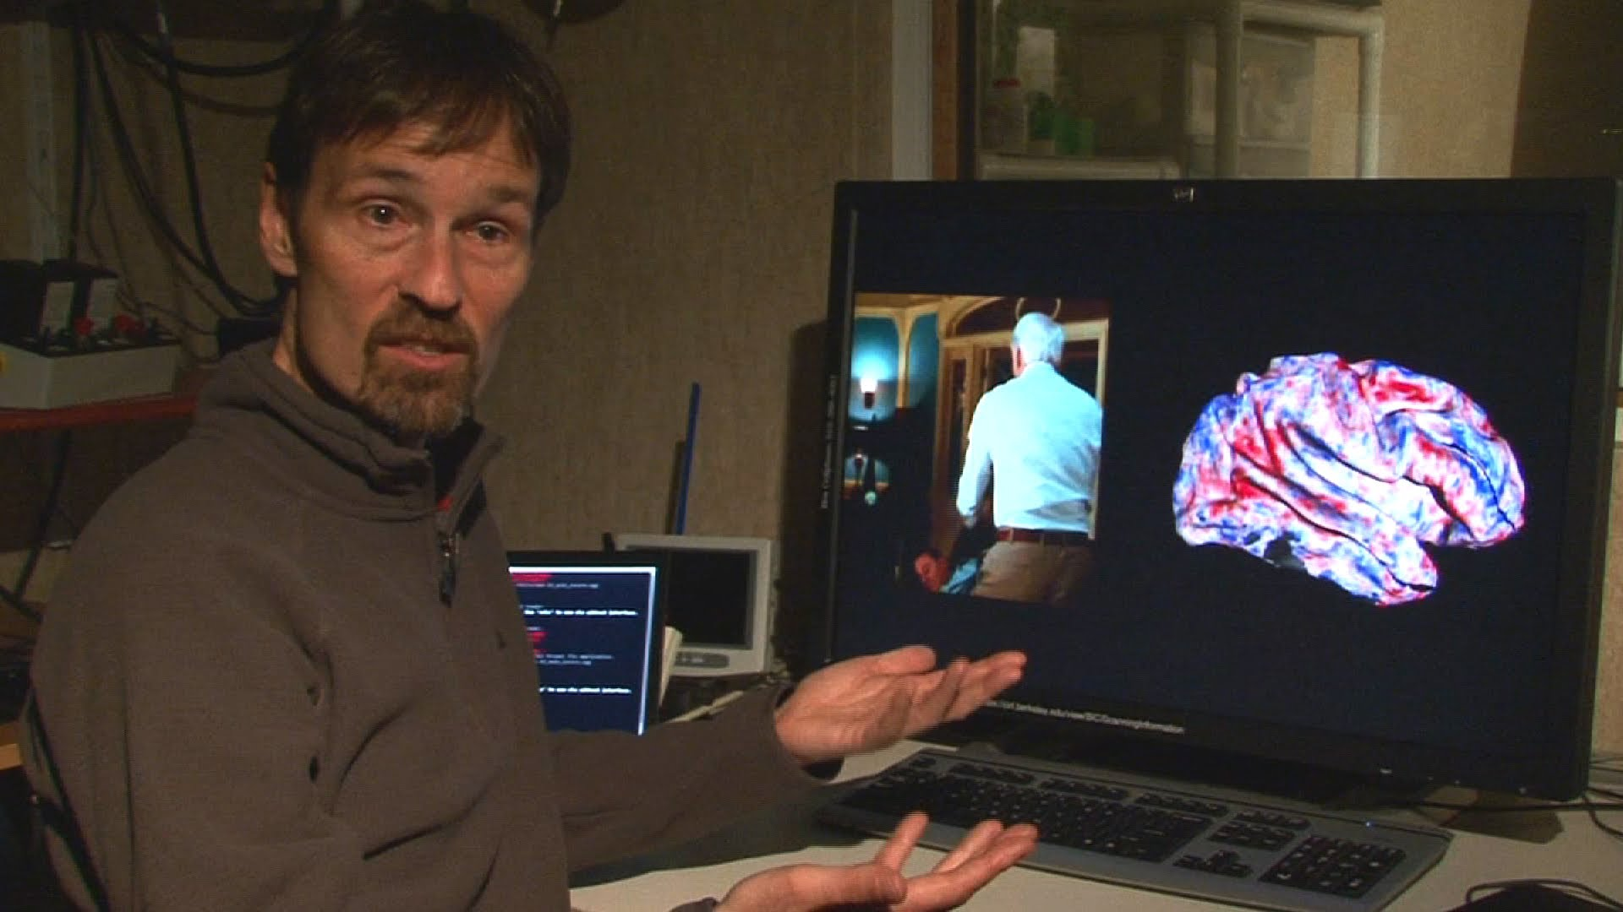
Pioneer
Nishimoto, S., Vu, A. T., Naselaris, T., Benjamini, Y., Yu, B., & Gallant, J. L. (2011). Reconstructing visual experiences from brain activity evoked by natural movies. Current Biology, 21(19), 1641-1646.
Nishimoto Shinji
Jack Gallant

Slide 6

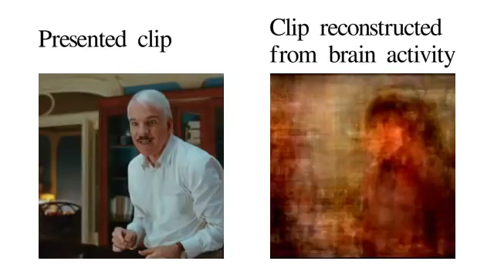
Results

Slide 7
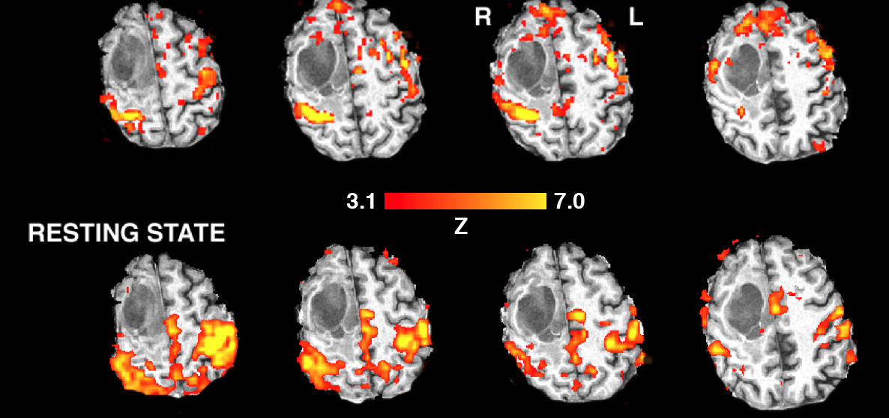
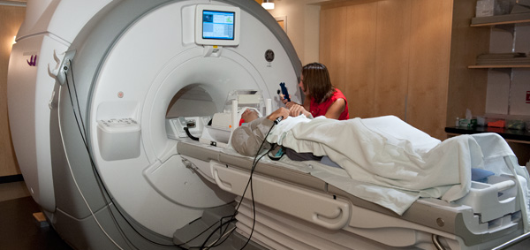
Sensor
fMRI (functional Magnetic Resonance Imaging)
한국어 : 뇌기능 자기공명영상
뇌가 활성화될때 일어나는 변화를 캡쳐
혈류내의 산소 용존량의 변화에따른 MR 신호의 크기변화를 측정하는 방식

Slide 8
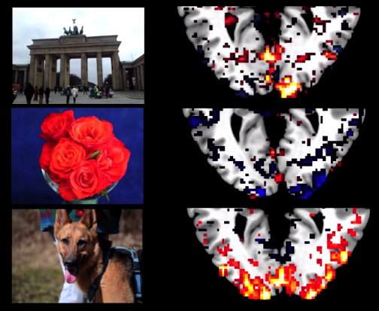


Experiment (Training)

Slide 9
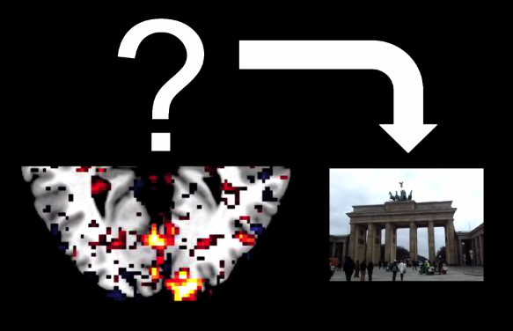

Experiment (Testing)

Slide 10
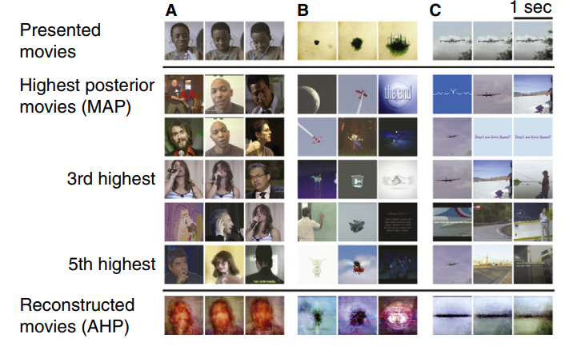
Results

Slide 11
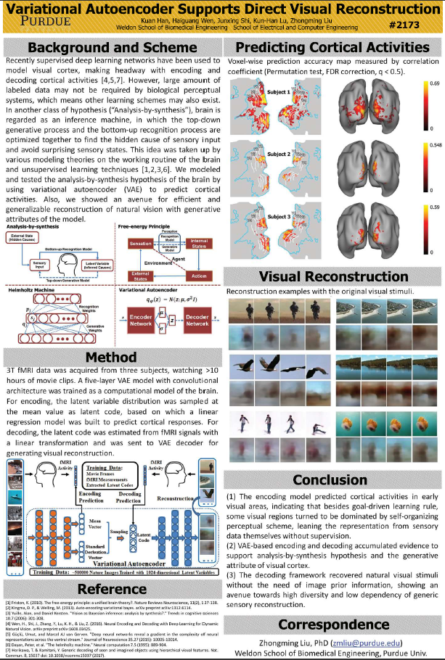
Today’s paper
Variational Autoencoder Support Direct Visual Reconstruction, Kuan Han, Kun-Han Lu, Zhonming Liu, 2017.6.26

Slide 12
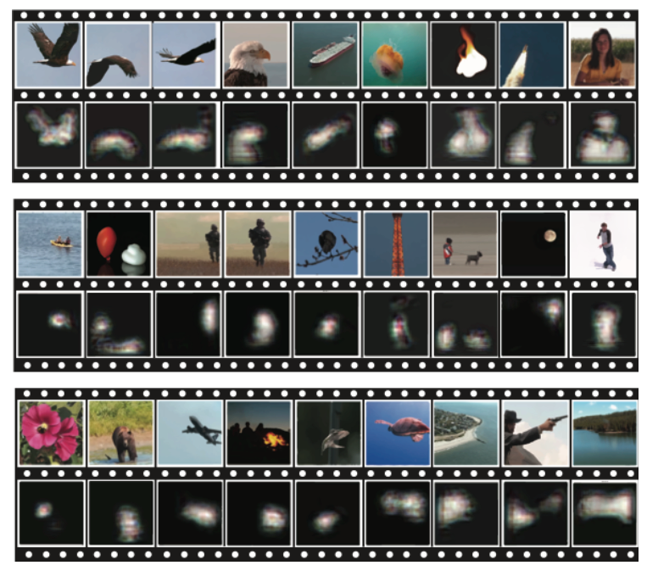
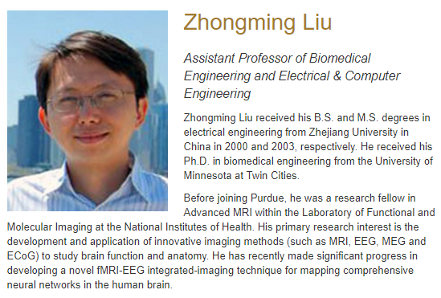
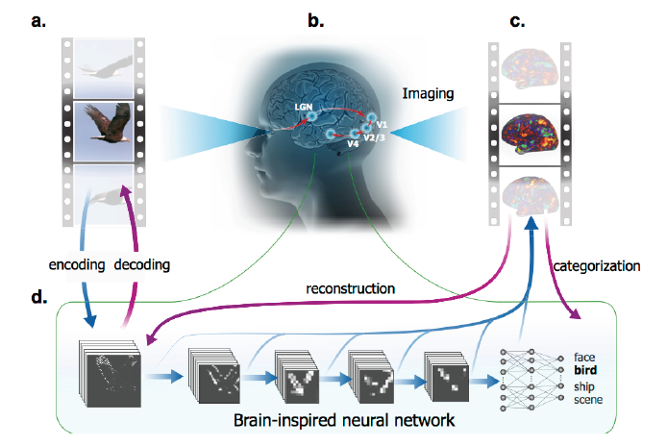
Who

Slide 13
Variational Autoencoder Support Direct Visual Reconstruction, Kuan Han, Kun-Han Lu, Zhonming Liu, 2017.6.26
Summarize
Deep learning 기반의 모델생성알고리즘(generative algorithm)
Variational Autoencoder (VAE)
fMRI 데이터를 활용
모델생성알고리즘으로 인간이 인지하는 뇌의 시각부분을 semi-directly 확인하겠다

Slide 14
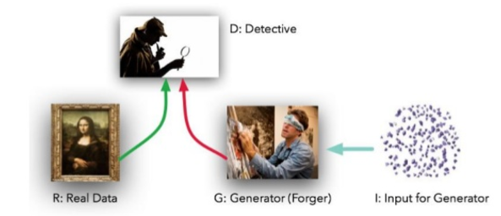
Deep Learning based Generative Algorithm 1
Generative Adversarial Networks(GAN)

Slide 15
Deep Learning based Generative Algorithm 2
Variational Auto-Encoder (VAE)

Slide 16
Keyword
Encoding
코드화, 암호화, 부호화
A라는형태의 데이터를 특정 규칙에 의해 B 데이터로 변환하는 과정
Decoding
Encoding의 반대

Slide 17

Autoencoder

Slide 18
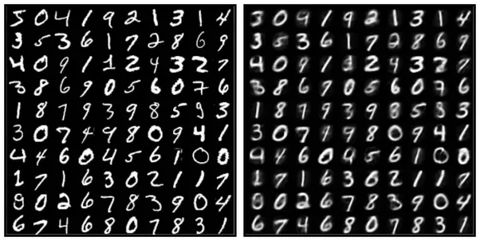
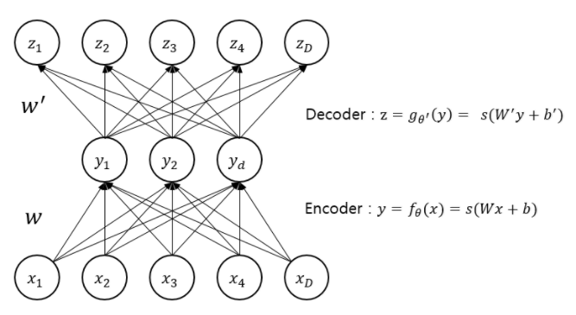
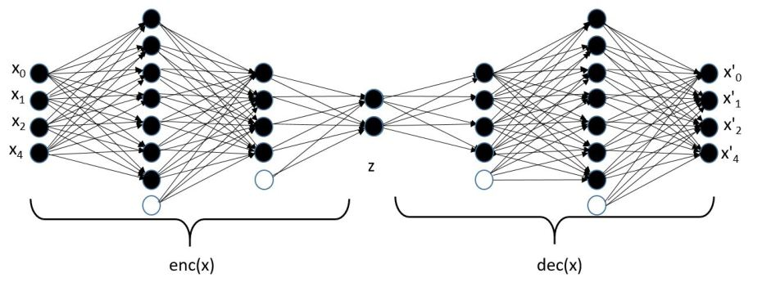
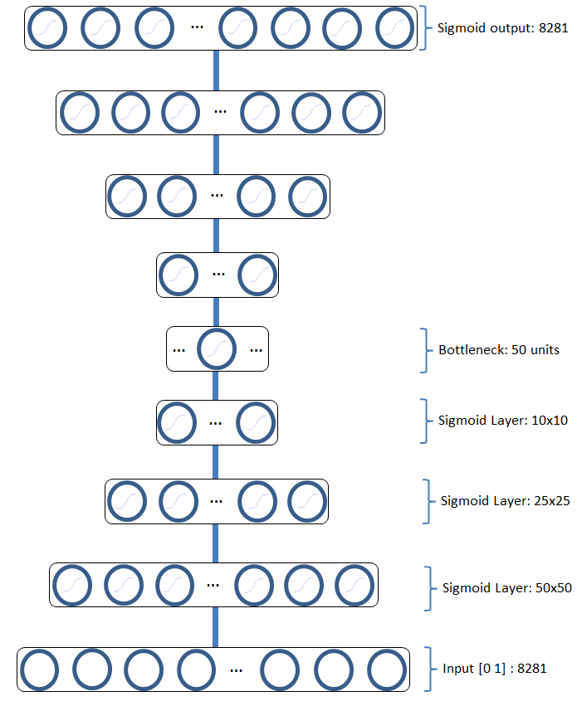
Autoencoder
정의
신경망의 입력층과 출력층의 노드갯수가 같은 알고리즘
특징
은닉층의 노드갯수는 입출력층보다 적다
비지도학습
Input = Output
압축을 위해 사용

Slide 19
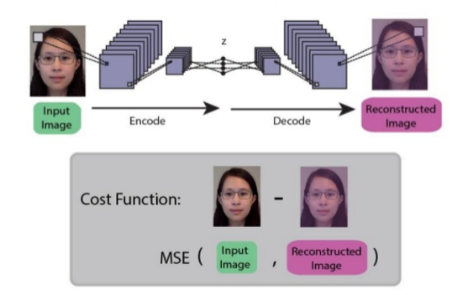
Autoencoder
정의
신경망의 입력층과 출력층의 노드갯수가 같은 알고리즘
특징
은닉층의 노드갯수는 입출력층보다 적다
비지도학습
Input = Output
압축을 위해 사용

Slide 20
Autoencoder(AE)
X = tf.placeholder(tf.float32, [None, 28,28,1]) #28x28x1 -> 14x14x16 W_conv1 = tf.Variable(tf.random_normal([5,5,1,16],stddev=0.01)) H_conv1 = tf.nn.conv2d(X, W_conv1,strides=[1,1,1,1],padding="SAME") H_conv1 = tf.nn.relu(H_conv1) H_conv1 = tf.nn.avg_pool(H_conv1,ksize=[1,2,2,1],strides=[1,2,2,1],padding="SAME") #14x14x16 -> 7x7x32 W_conv2 = tf.Variable(tf.random_normal([5,5,16,32], stddev=0.01)) H_conv2 = tf.nn.conv2d(H_conv1, W_conv2,strides=[1,1,1,1],padding="SAME") H_conv2 = tf.nn.relu(H_conv2) H_conv2 = tf.nn.avg_pool(H_conv2,ksize=[1,2,2,1],strides=[1,2,2,1],padding="SAME") #7x7x32(1568)x 20 W_conv3 = tf.Variable(tf.random_normal([1568, 3],stddev=0.01)) H_conv3 = tf.reshape(H_conv2, [-1, 1568]) H_conv3 = tf.matmul(H_conv3, W_conv3) H_conv3 = tf.nn.relu(H_conv3)
Tensorflow

Slide 21
Autoencoder(AE)
#2 x 1568 W_d_conv0 = tf.Variable(tf.random_normal([3, 1568],stddev=0.01)) H_d_conv0 = tf.reshape(H_conv3, [-1, 3]) H_d_conv0 = tf.matmul(H_d_conv0, W_d_conv0) H_d_conv0 = tf.nn.relu(H_d_conv0) H_d_conv0 = tf.reshape(H_d_conv0, [-1, 7,7,32]) #7x7x32 -> 14x14x16 W_d_conv1 = tf.Variable(tf.random_normal([5,5,16,32], stddev=0.01)) H_d_conv1 = tf.nn.conv2d_transpose(H_d_conv0, W_d_conv1,output_shape = [batchSize, 14,14,16], strides=[1,2,2,1], padding="SAME") H_d_conv1 = tf.nn.relu(H_d_conv1) #14x14x16 -> 28x28x1 W_d_conv2 = tf.Variable(tf.random_normal([5,5,1,16],stddev=0.01)) H_d_conv2 = tf.nn.conv2d_transpose(H_d_conv1, W_d_conv2, output_shape= [batchSize, 28,28, 1], strides = [1,2,2,1], padding = "SAME") H_d_conv2 = tf.nn.relu(H_d_conv2) x_reconstruct = H_d_conv2
Tensorflow

Slide 22
Autoencoder(AE)
cost = tf.reduce_mean(tf.pow(x_reconstruct-X,2)) optimizer = tf.train.AdamOptimizer(0.001).minimize(cost) sess = tf.Session() sess.run(tf.global_variables_initializer()) saver = tf.train.Saver(tf.global_variables()) for epoch in range(0,200): for step in range(0, DB_TR.total_batch): _, cost_current = sess.run([optimizer, cost], feed_dict={X:DB_TR_MiniBatch_Data}) print(epoch, step, cost_current)

Slide 23
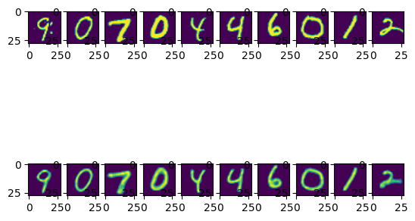
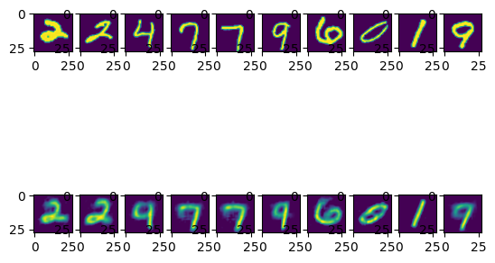
Autoencoder(AE)
Latent Vector : 20
Latent Vector : 3
Epoch : 20
Epoch : 110

Slide 24
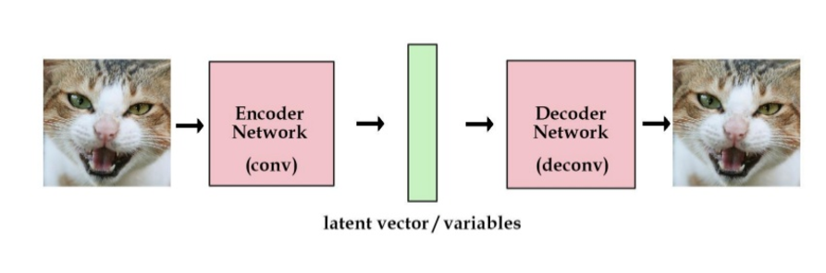
Autoencoder(AE)
Autoencoder (AE)
Reconstruction

Slide 25
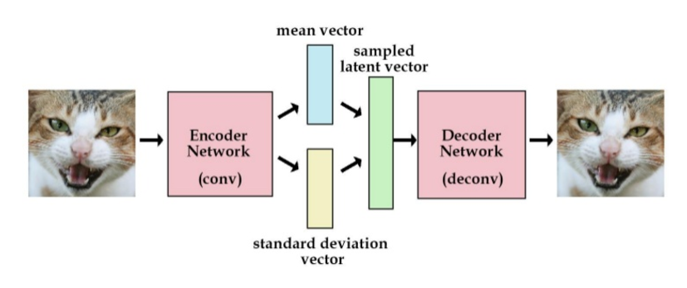
Variational Autoencoder(VAE)
Variational Autoencoder (VAE)
Reconstruction + Variation

Slide 26
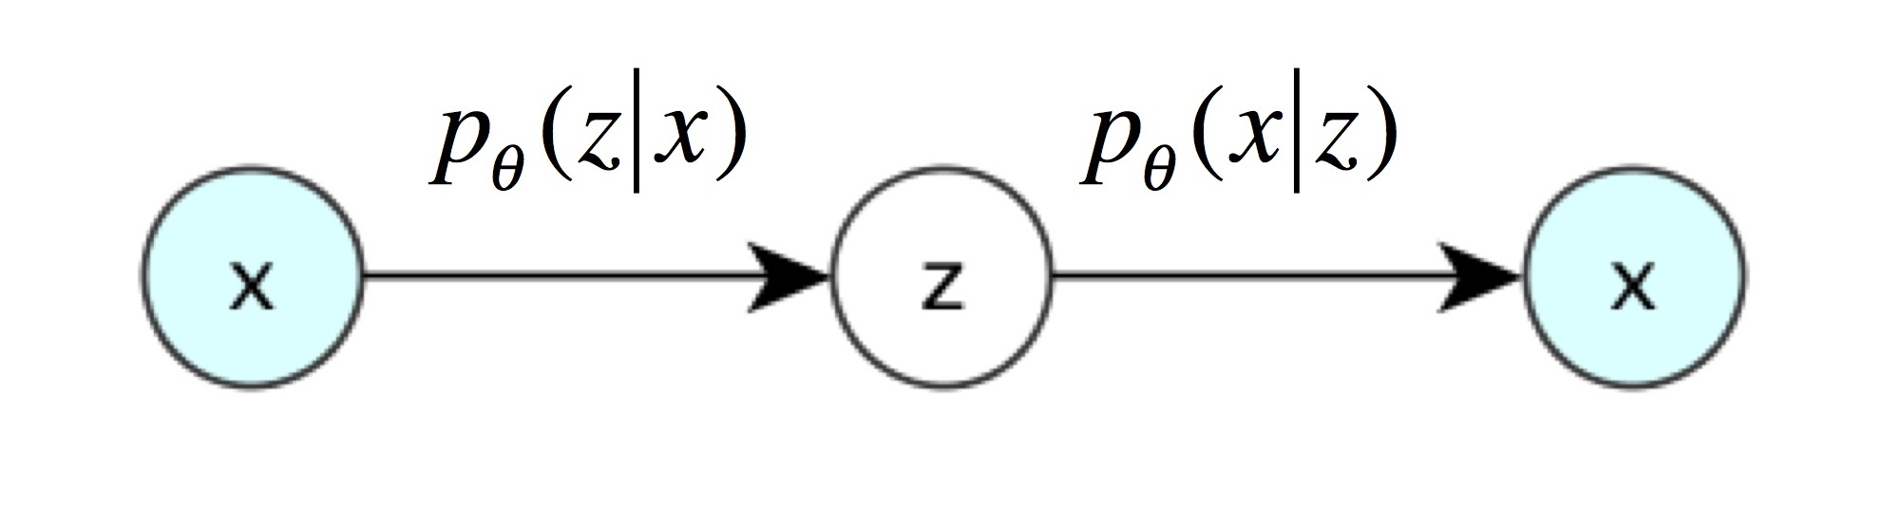
Variational Autoencoder(VAE)
Variational Autoencoder (VAE)
AE에서는 latent vector Z가 sparse한 값을 가지는 deterministic한 값
VAE에서는 latent vector Z가 continuous한 분포를 가지는 random variable값
Latent vector Z가 평균 + 표준편차로 결정되는 확률분포를 가짐
Encoder는 x로부터 z를 얻을 확률 p(Z|X)를 학습
Decoder는 z로부터 x를 얻을 확률 p(X|Z)를 학습

Slide 27
Variational Autoencoder(VAE)
Objective Function
Decoder를 X와 비슷한 데이터가 output으로 나오도록 학습
Maximize P(X)

Slide 28
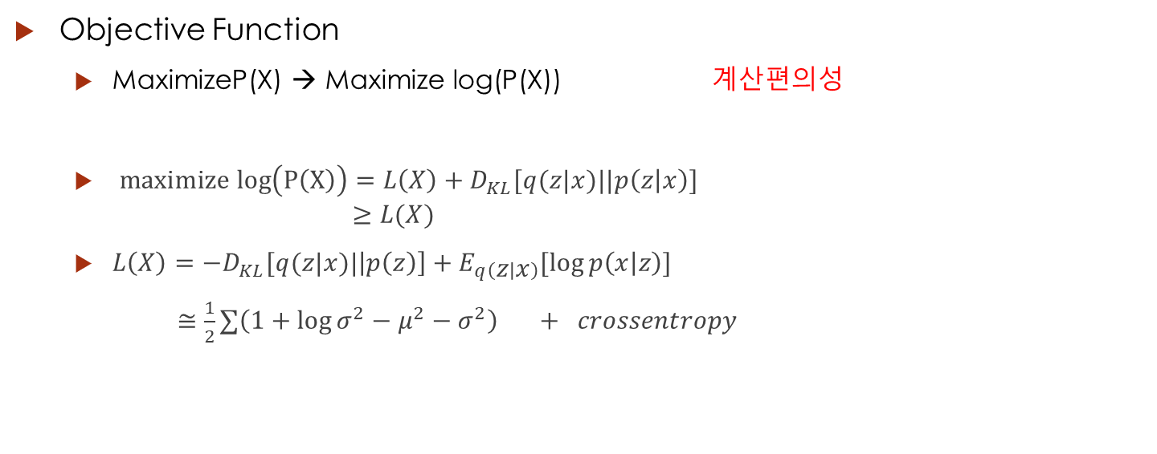
Variational Autoencoder(VAE)
Objective Function
MaximizeP(X) → Maximize log(P(X)) 계산편의성
$maximize log\left(P\left(X\right)\right)=L\left(X\right)+D_{KL}[q(z|x)||p\left(z | x\right)]$ $≥L(X)$
$L\left(X\right)=−D_{KL}[q(z|x)|\left|p\left(z\right)\right]+E_{q\left(z | x\right)}[log⁡p\left(x | z\right)]$
$≅\frac{1}{2}∑\left(1+\log{σ^{2}}−μ^{2}−σ^{2}\right) + crossentropy$
ELBO
regularizer
Reconstruction loss

Slide 29
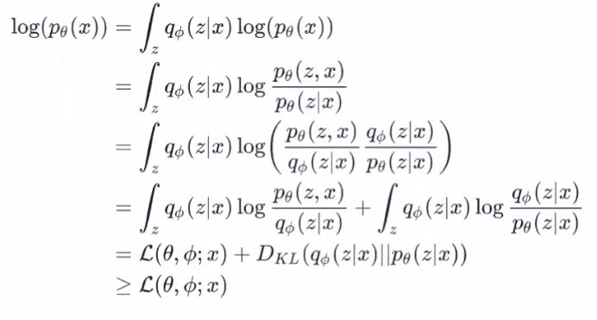
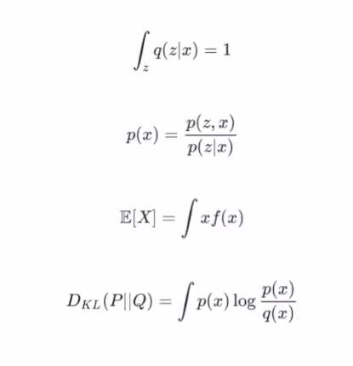
Variational Autoencoder(VAE)
Bayes theorem

Slide 30
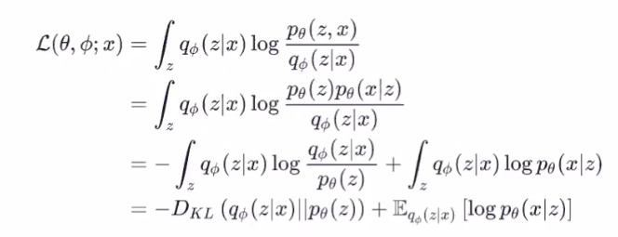
Variational Autoencoder(VAE)

Slide 31
VAE
X = tf.placeholder(tf.float32, [None, imSize[0], imSize[1], 1]) #28x28x1 -> 14x14x16 W_E_1 = tf.Variable(tf.random_normal([5,5,1,16],stddev=0.01)) H_E_1 = tf.nn.conv2d(X, W_E_1,strides=[1,1,1,1],padding="SAME") H_E_1 = tf.nn.relu(H_E_1) H_E_1 = tf.nn.avg_pool(H_E_1,ksize=[1,2,2,1],strides=[1,2,2,1],padding="SAME") #14x14x16 -> 7x7x64 W_E_2 = tf.Variable(tf.random_normal([5,5,16,32], stddev=0.01)) H_E_2 = tf.nn.conv2d(H_E_1, W_E_2,strides=[1,1,1,1],padding="SAME") H_E_2 = tf.nn.relu(H_E_2) H_E_2 = tf.nn.avg_pool(H_E_2,ksize=[1,2,2,1],strides=[1,2,2,1],padding="SAME") H_E_2 = tf.reshape(H_E_2, [-1, 1568]) #7x7x32(1568)x 200 W_E_3 = tf.Variable(tf.random_normal([1568, 200],stddev=0.01)) H_E_3 = tf.matmul(H_E_2, W_E_3) H_E_3 = tf.nn.relu(H_E_3) H_E_3 = tf.reshape(H_E_3, [-1, 200]) latent_vector_length = 2 W_E_4 = tf.Variable(tf.random_normal([200, latent_vector_length*2], stddev=0.01)) H_E_4 = tf.matmul(H_E_3, W_E_4) H_E_4 = tf.nn.relu(H_E_4) mu = H_E_4[:,:latent_vector_length] sigma =H_E_4[:,latent_vector_length:] epsilon =tf.random_normal(tf.shape(mu),dtype=tf.float32) Z = mu + tf.multiply(sigma,epsilon) Z = tf.reshape(Z, [-1, latent_vector_length])
Tensorflow
Python

Slide 32
VAE
#latent vector length x 1568 W_D_1 = tf.Variable(tf.random_normal([latent_vector_length, 1568],stddev=0.01)) H_D_1 = tf.matmul(Z, W_D_1) H_D_1 = tf.nn.relu(H_D_1) H_D_1 = tf.reshape(H_D_1, [-1, 7, 7, 32]) #7x7x32 -> 14x14x16 W_D_2 = tf.Variable(tf.random_normal([5,5,16,32], stddev=0.01)) H_D_2 = tf.nn.conv2d_transpose(H_D_1, W_D_2,output_shape = [batchSize, 14,14,16], strides=[1,2,2,1], padding="SAME") H_D_2 = tf.nn.relu(H_D_2) #14x14x16 -> 28x28x1 W_D_3 = tf.Variable(tf.random_normal([5,5,1,16],stddev=0.01)) H_D_3 = tf.nn.conv2d_transpose(H_D_2, W_D_3, output_shape= [batchSize, 28,28, 1], strides = [1,2,2,1], padding = "SAME") H_D_3 = tf.nn.relu(H_D_3) X_Re = tf.clip_by_value(H_D_3, EP , 1 - EP) loss_KL = -0.5*tf.reduce_sum(1.0+tf.log(tf.square(sigma+EP))-tf.square(mu)-tf.square(sigma),reduction_indices=1) loss_reconst = -tf.reduce_sum(X*tf.log(X_Re+EP)+(1.0-X)*tf.log(1.0-X_Re+EP),reduction_indices=[1,2]) loss = tf.reduce_mean(loss_reconst+loss_KL) optimizer = tf.train.AdamOptimizer(0.001).minimize(loss) sess = tf.Session() sess.run(tf.global_variables_initializer()) saver = tf.train.Saver(tf.global_variables())
Tensorflow
Python

Slide 33
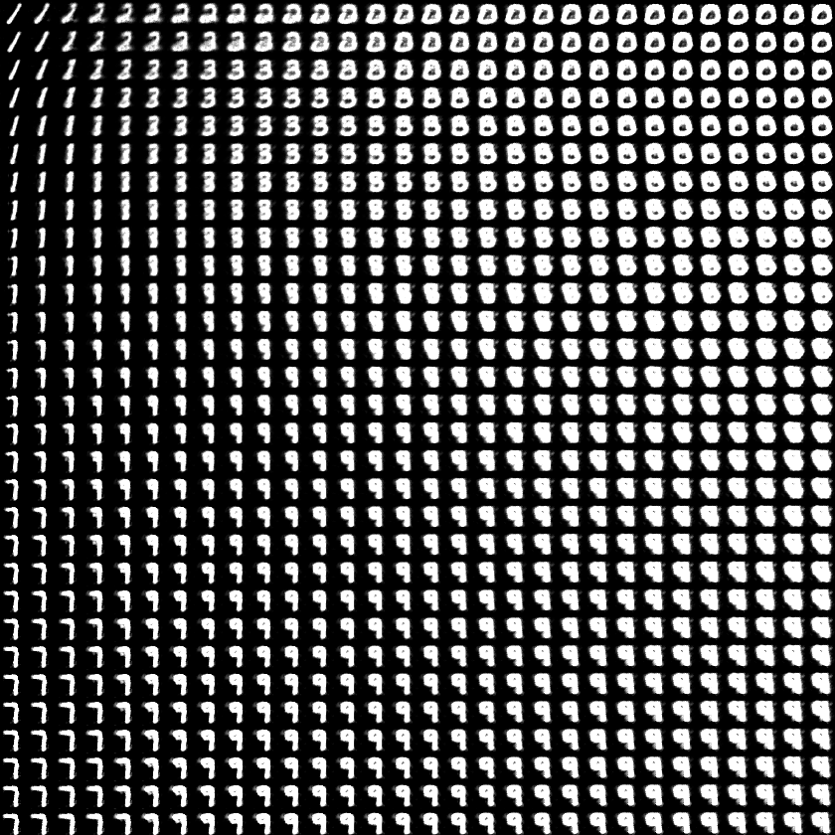
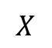
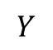
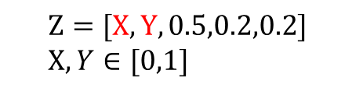
Variational Autoencoder(VAE)
$$Y$$
Latent Vector : 5
$$Z=[X,Y, 0.5,0.2,0.2] \\ X,Y∈[0,1]$$
$$X$$

Slide 34
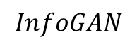
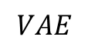
Variational Autoencoder(VAE)
$$InfoGAN$$
$$VAE$$

Slide 35
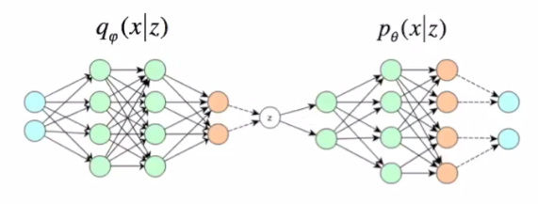
Variational Autoencoder(VAE)

Slide 36
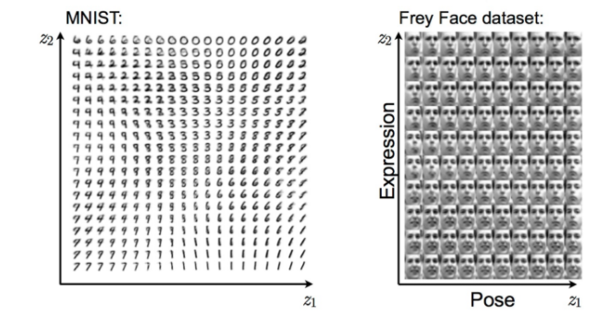
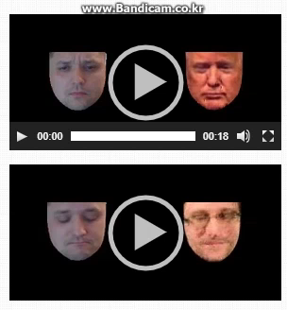
Variational Autoencoder(VAE)
Variational Autoencoder (VAE)
Visualization (Example) Latent space walking

Slide 37
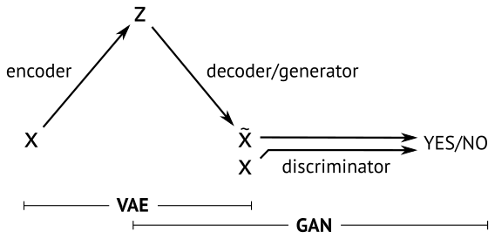
VAE and GAN

Slide 38
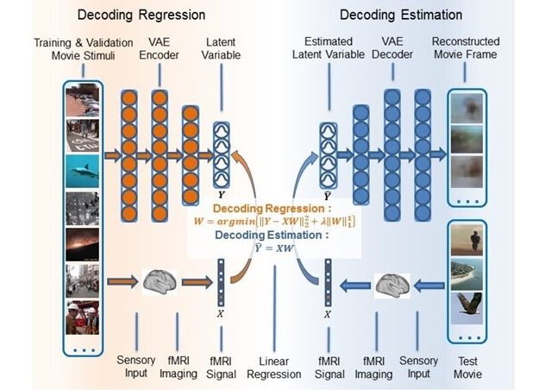
Neural(Brain) E/D coding
Decoding Cortical Activity with Variational Autoencoder Supports Direct Visual Reconstruction, 2017.06.26,

Slide 39
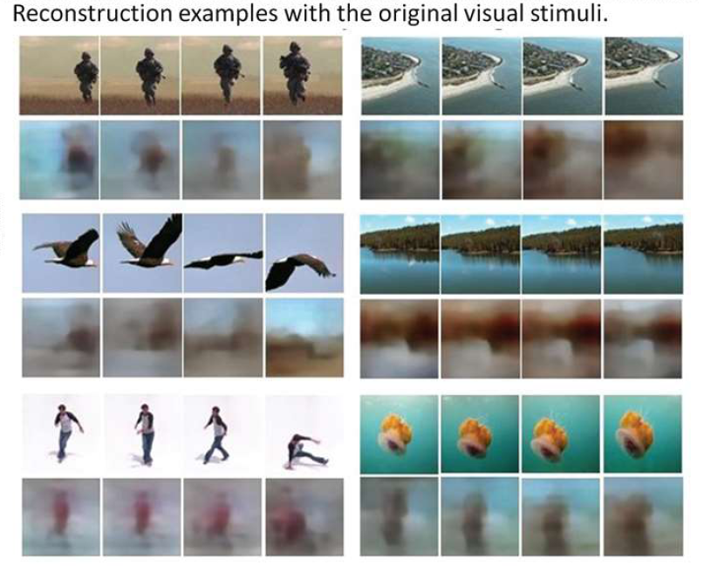
Neural(Brain) E/D coding

Slide 40
Q & A
No Thank you

